Slide 1
CHAPTER 4 DATA MOVEMENT INSTRUCTIONS

Slide 2
Intel Assembly
Data Movement Instruction:
􀁐 mov (covered already)
􀁐 push, pop
􀁐 lea (mov and offset)
􀁐 lds, les
􀁐 movs, lods, stos
􀁐 ins, outs
􀁐 xchg, xlat
􀁐 lahf, sahf (not covered)
􀁐 in, out

Slide 3
Stack Instructions
The push and pop are important instructions that store and retrieve data from the LIFO stack memory.
There are six forms of the push and pop instructions.
Register, memory (memory-to-memory copy), immediate, segment register, flags, and
all registers. The PUsH-POP immediate and PUshA-POPa are not available in 8086/8088.

Slide 4
push:
The source of the data may be:
Any 16- or 32-bit register, immediate data(!!!), any segment register, any word or doubleword of memory data.
pushad pushes eax, ecx, edx, ebx, esp, ebp, edi and esi where the value of esp saved on the stack is its value before the pushad. Pusha is used for 16 bit registers (order:ax, cx, dx,bx,sp,bp,sı and dı ).
Pushf copies the the contents of the flag register to the stack.
Push immediate has two opcodes for 16 bit and 32 bit data
(00H-FFH)->6AH
0100H-FFFFH->68H
push 0008h : 6A08
Push 1000h: 680010

Slide 5
Whatever data are pushed on the stack, the most significant data moves into the SS memory location adressed by sp-1. The least sig. data goes to the memory location addressed by sp-2. Then the contents of the SP register decrement by 2. (16 bit push!!!)

Slide 6
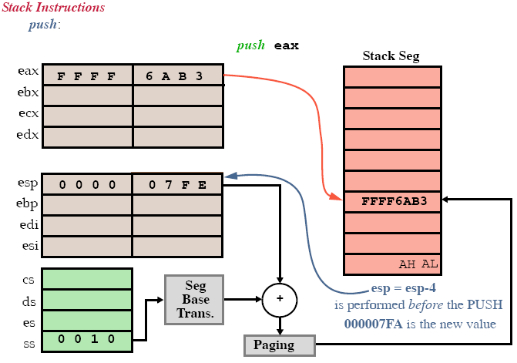

Slide 7
pop:
The source of the data may be:Any 16- or 32-bit register, any segment register (except for cs), any word or doubleword of memory data.
No pop for immediate data!!
The popf inst. removes 16 bit number from the stack and places it into the Flag reg.(popfd for EFLAG)
popa (pop all) removes 16 bytes of data from the stack and places it into the dı,sı,bp,sp,bx,dx,cx and ax.
Example: pop bx
The first byte of data removed from the stack (addressed by sp) moves into BL. The second byte of data is removed from the stack(sp+1) . Then sp=sp+2.

Slide 8
Address Loading Instructions
Load-Effective Address.
lea:
Loads any 16 bit or 32-bit register with the offset address of the data, as specified by the instruction addressing mode.
LEA AX, NUMB : loads ax with address of the NUMB. Not the content of the NUMB!!!
lea versus mov:
LEA BX, [DI] : loads the offset address specified by di into bx register.
Mov bx, [dı] : loads the data stored by the dı into register bx.
Lea bx,[dı] : ıf dı contains 1000h (as an offset adress) then bx=di; same as mov bx, di.

Slide 9
The offset directive performs the same function as an lea instruction if the operand is displacement.
Mov bx, offset list = lea bx, list
executing “Lea bx, list” takes longer than executing “lea bx, list”.
lds and les:
Load a 16-bit register with an offset address and then ds or es with a segment adress.
Fig 4.15
lds edi, LIST ;Loads edi and ds.
lea eax,[ebx+ecx*4+100] ;Loads eax with computed address.

Slide 10
String Operations
movs, lods, stos, ins, outs
Allow data transfers of a byte, a word or a double word, or if repeated, a block of each of these.
The D flag-bit (direction), esi and edi are implicitly used.
􀁑 D = 0: Auto increment edi and esi.
Use cld instruction to clear this flag.
􀁑 D = 1: Auto decrement edi and esi.
Use std instruction to set it.
edi:
Accesses data in the extra segment. Can NOT override.
esi:
Accesses data in the data segment. Can be overridden with segment override prefix.

Slide 11
String Operations
lods:
Loads al, ax or eax with data stored at the data segment (or extra segment) + offset given by esi.
esi is incremented or decremented afterwards:
lodsb ;al=ds:[si]; si=si+/-1
lodsd ;eax=ds:[esi]; esi=esi+/-4
lodsw; ax=ds:[si]; si=si+/-2
stosb:
Stores al, ax or eax to the extra segment (es) + offset given by edi. es cannot be overridden.
edi is incremented or decremented afterwards:
stosb ;es:[di]=al; di=di+/-1
stosd ;es:[edi]=eax; edi=edi+/-4

Slide 12
String Operations
rep prefix:
Executes the instruction ecx times.
NOTE: rep does not make sense with the lodsb instruction.
movs:
Moves a byte, word or doubleword from data segment and offset esi to extra segment and offset edi.
Increments/decrements both edi and esi:
movsb ;es:[di]=ds:[si]; di+/-=1; si+/-=1
movsd ;es:[edi]=ds:[esi]; edi+/-=4; esi+/-=4
movsw ; es:[di]=ds:[si]; di+/-=2; si+/-=2

Slide 13
xchg:
Exchanges the contents of a register with the contents of any other register or memory location.
It can NOT exchange segment registers or memory-to-memory data.
Byte, word and doublewords can be exchanged using any addressing mode (except immediate, of course).
xchg edx, esi ;Exchange edx and esi
Xchg cx,bp
Xchg al,data2

Slide 14
LAHF and SAHF
The LAFH transfers the rightmost 8 bits of the flag into AH.
The SAHF tranfers the AH into the rightmost 8 bits of the flag

Slide 15
XLAT
Converts the contents of AL into a number stored in a memory table. (Table lookup technique!)
Figure 4.17
Example 4.6

Slide 16
IN and OUT
Perform I/o operations.
The contents of AL or AX transfered only between I/o Device and Mprocessor.
IN: AL<--IO device(port) (fixed or varable)
Out: AL→IO device(port) “ ”
İn al, p8; in ax, p8; in al, dx; in ax, dx
out p8, al; out p8, ax; out dx, al; out dx, ax
Ex 4.7
Fig 4.18

